Slide 1

” One generation shall praise thy works to another, And shall declare thy mighty acts”.
Psalm 145:4

Slide 2
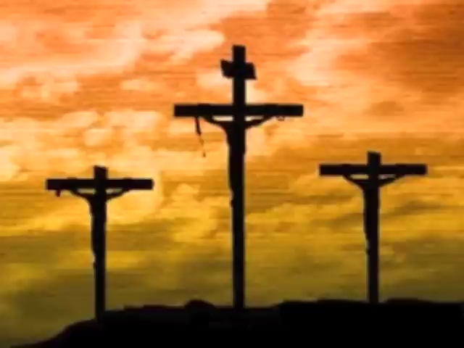

Slide 3
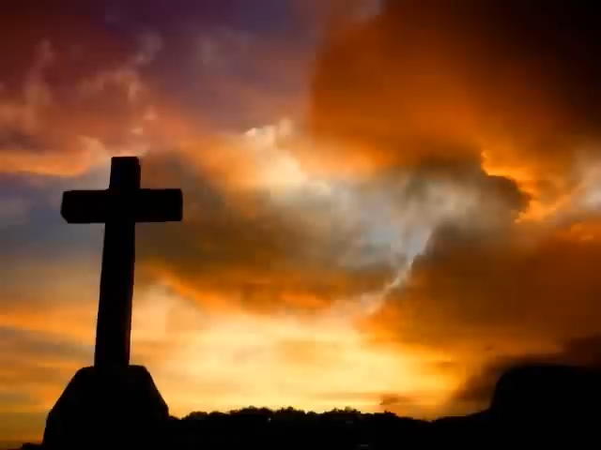

Slide 4


Slide 5
At Calvary
https://youtu.be/Gt3BrYsVzQ8
Worthy Is The Lamb
https://youtu.be/LAplJ0_jDFc
There Is A fountain
https://youtu.be/QF8sPZmP8fU

Slide 6
” One generation shall praise thy works to another, And shall declare thy mighty acts”.
Psalm 145:4

