Slide 1

” One generation shall praise thy works to another, And shall declare thy mighty acts”.
Psalm 145:4

Slide 2


Slide 3
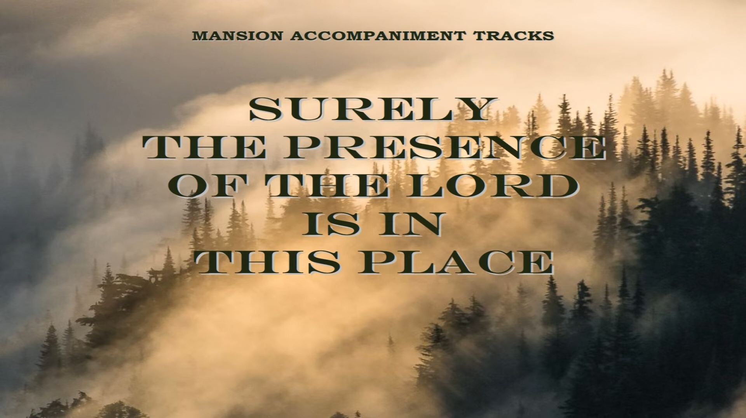

Slide 4


Slide 5
In the Presence of Jehovah - Geron Davis
https://www.youtube.com/watch?v=cexLR_A9Llo
"Surely The Presence Of The Lord Is In This Place" Southern Gospel hymn/chorus
https://www.youtube.com/watch?v=p-jexka712g
Brian Ortize // Way Maker // Official Lyric Video
https://www.youtube.com/watch?v=67UjAs6hREc

Slide 6
” One generation shall praise thy works to another, And shall declare thy mighty acts”.
Psalm 145:4

