Slide 1

” One generation shall praise thy works to another, And shall declare thy mighty acts”.
Psalm 145:4

Slide 2
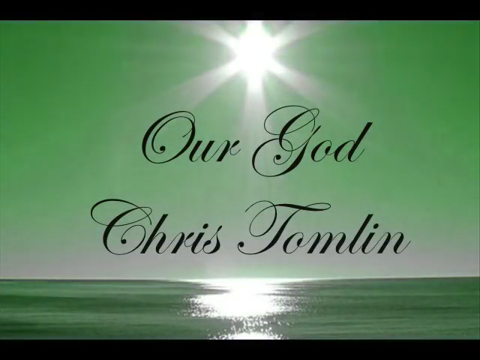

Slide 3


Slide 4


Slide 5
Our God (Is Greater) by Chris Tomlin (w/ lyrics)
https://www.youtube.com/watch?v=p-6YdT1DEO8
How Great Is Our God - Lyric Video HD
https://www.youtube.com/watch?v=wDgmJFw6F64
How Great Thou Art with Lyrics (Hymn) - Matt Redman (Cover)
https://www.youtube.com/watch?v=wY4SlbeyUig

Slide 6
” One generation shall praise thy works to another, And shall declare thy mighty acts”.
Psalm 145:4

