Slide 1

” One generation shall praise thy works to another, And shall declare thy mighty acts”.
Psalm 145:4

Slide 2


Slide 3
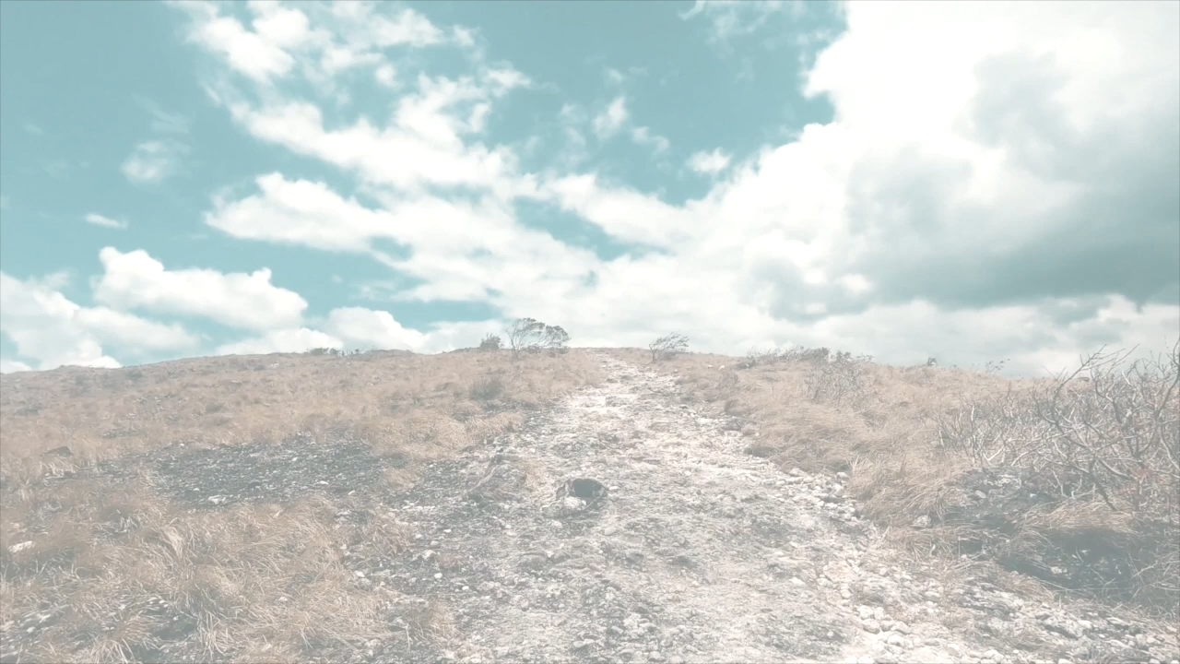

Slide 4


Slide 6
There Is a Fountain Filled with Blood (Lyrics)
https://www.youtube.com/watch?v=txXXWipQdHU
What Can Wash Away My Sin Josh Lucas
https://youtu.be/DZjGJaKeROI?si=QTFPXY4jl3t5_Qwh
The Blood Will Never Lose Its Power
https://www.youtube.com/watch?v=RUaPifIayjs

Slide 7
” One generation shall praise thy works to another, And shall declare thy mighty acts”.
Psalm 145:4

