Slide 1

” One generation shall praise thy works to another, And shall declare thy mighty acts”.
Psalm 145:4

Slide 2


Slide 3
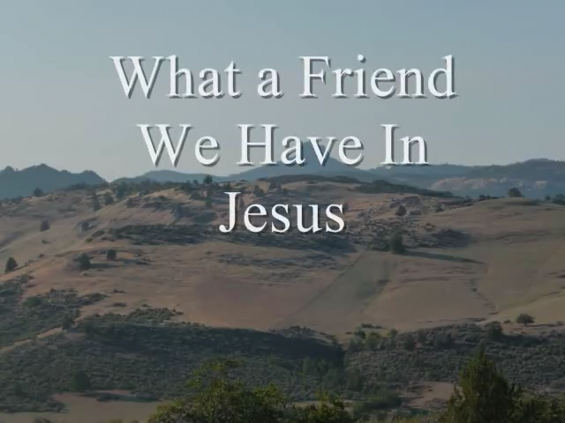

Slide 4


Slide 5
There’s Something About That Name
https://youtu.be/W09KqLV5E2Y?si=pRz6XQuZquNVqnb2
What A Friend
https://youtu.be/8SCorW9r_Is?si=8ua5Kg2jH3fRmETV
I Speak Jesus
https://youtu.be/3wJw2YOEL_U?si=czRf5pFSzM8H7KQ1

Slide 6
” One generation shall praise thy works to another, And shall declare thy mighty acts”.
Psalm 145:4

