Slide 1

” One generation shall praise thy works to another, And shall declare thy mighty acts”.
Psalm 145:4

Slide 2


Slide 3
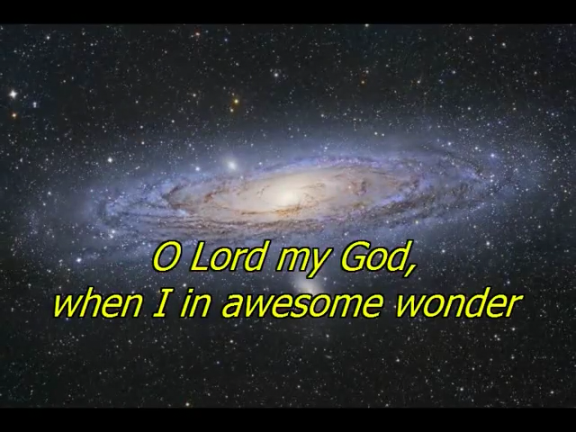

Slide 4


Slide 5
It is Well with My Soul • T4G Live [Official Lyric Video]
https://www.youtube.com/watch?v=rhaTIu_k4w0
How great Thou art
https://www.youtube.com/watch?v=3GKhDCsLrUg
Ten Thousand Reasons Matt Redman -Lyrics
https://www.youtube.com/watch?v=qoxZFtWNHd8

Slide 6
” One generation shall praise thy works to another, And shall declare thy mighty acts”.
Psalm 145:4

