Slide 1

” One generation shall praise thy works to another, And shall declare thy mighty acts”.
Psalm 145:4

Slide 2


Slide 3


Slide 4


Slide 5
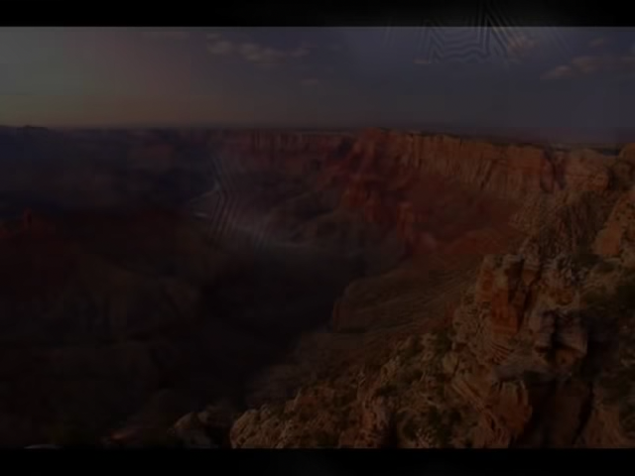

Slide 6
Holy Holy Holy
https://www.youtube.com/watch?v=HogearVs48Q
Bless The Lord
https://www.youtube.com/watch?v=qoxZFtWNHd8
My Hope Is Built
https://www.youtube.com/watch?v=rkMapZB8qMk

Slide 8
” One generation shall praise thy works to another, And shall declare thy mighty acts”.
Psalm 145:4

