Slide 1

” One generation shall praise thy works to another, And shall declare thy mighty acts”.
Psalm 145:4

Slide 2


Slide 3
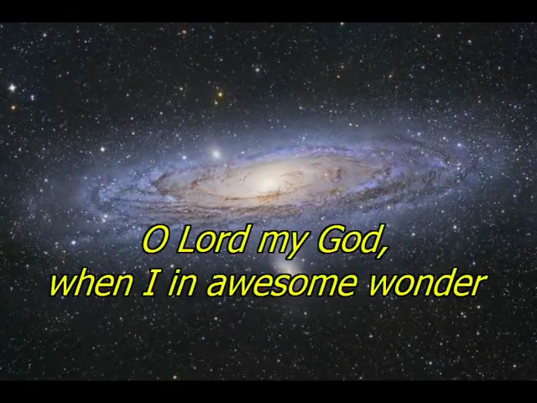

Slide 4


Slide 5
I Speak Jesus
https://www.youtube.com/watch?v=3wJw2YOEL_U
How Great Thou Art
https://www.youtube.com/watch?v=3GKhDCsLrUg
Learning To Lean On Jesus
https://www.youtube.com/watch?v=eMnUIL6mYvI

Slide 6
” One generation shall praise thy works to another, And shall declare thy mighty acts”.
Psalm 145:4

