Slide 1

” One generation shall praise thy works to another, And shall declare thy mighty acts”.
Psalm 145:4

Slide 2


Slide 3


Slide 5
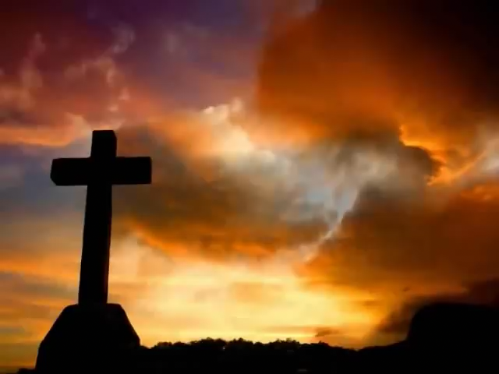

Slide 7
I Speak Jesus
https://www.youtube.com/watch?v=3wJw2YOEL_U
Worthy Is The Lamb
https://www.youtube.com/watch?v=LAplJ0_jDFc

Slide 9
” One generation shall praise thy works to another, And shall declare thy mighty acts”.
Psalm 145:4

