Slide 1

” One generation shall praise thy works to another, And shall declare thy mighty acts”.
Psalm 145:4

Slide 2


Slide 3


Slide 4
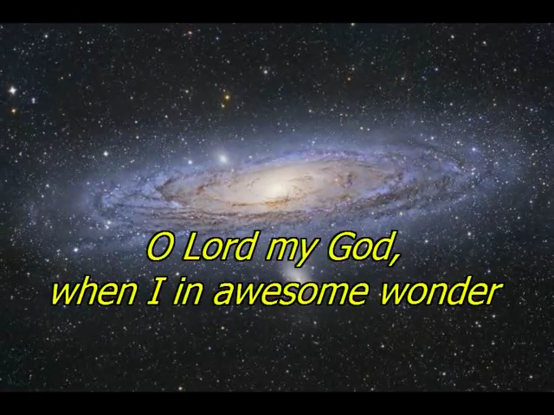

Slide 5
How Great Thou Art
Verse 1
Oh Lord, my God
When I in awesome wonder
Consider all the worlds
Thy hands have made

Slide 6
How Great Thou Art
Verse 1
I see the stars,
I hear the rolling thunder
Thy power throughout the universe displayed

Slide 7
How Great Thou Art
Chorus
Then sings my soul
My Savior God to Thee
How great Thou art
How great Thou art
(repeat)

Slide 8
How Great Thou Art
Verse 2
And when I think that God
His Son not sparing
Sent Him to die
I scarce can take it in

Slide 9
How Great Thou Art
Verse 2
That on the cross
My burden gladly bearing
He bled and died to
Take away my sin

Slide 10
How Great Thou Art
Chorus
Then sings my soul
My Savior God to Thee
How great Thou art
How great Thou art
(repeat)

Slide 11
How Great Thou Art
Verse 3
And when I think that God
His Son not sparing
Sent Him to die
I scarce can take it in

Slide 12
How Great Thou Art
Verse 3
That on the cross
My burden gladly bearing
He bled and died to
Take away my sin

Slide 13
How Great Thou Art
Chorus
Then sings my soul
My Savior God to Thee
How great Thou art
How great Thou art
(repeat)

Slide 14
How Great Thou Art
Verse 4
When Christ shall come
With shout of acclamation
And take me home
What joy shall fill my heart

Slide 15
How Great Thou Art
Verse 4
Then I shall bow
In humble adoration
And then proclaim
My God
How great Thou art

Slide 16
How Great Thou Art
Chorus
Then sings my soul
My Savior God to Thee
How great Thou art
How great Thou art
(repeat)

Slide 18
You Tube you tube url’s
Because He Lives
https://www.youtube.com/watch?v=4M-zwE33zHA
How Great Is Our God
https://www.youtube.com/watch?v=wDgmJFw6F64
How Great Thou Art
https://www.youtube.com/watch?v=3GKhDCsLrUg

Slide 19
” One generation shall praise thy works to another, And shall declare thy mighty acts”.
Psalm 145:4

