Slide 1

” One generation shall praise thy works to another, And shall declare thy mighty acts”.
Psalm 145:4

Slide 2


Slide 3
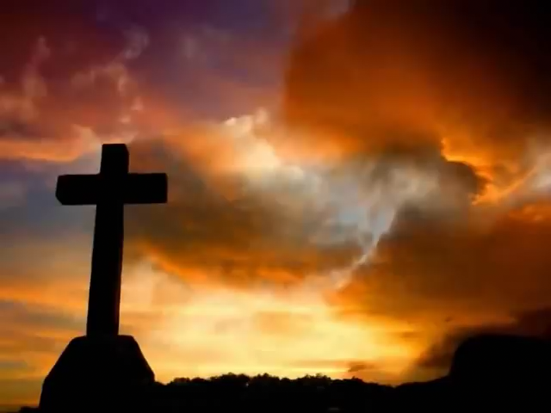

Slide 4
You Tube you tube url’s
I Speak Jesus
https://www.youtube.com/watch?v=DHKTQ1il1M8
Worthy Is The Lamb
https://www.youtube.com/watch?v=LAplJ0_jDFc

Slide 5
” One generation shall praise thy works to another, And shall declare thy mighty acts”.
Psalm 145:4

