Slide 1

” One generation shall praise thy works to another, And shall declare thy mighty acts”.
Psalm 145:4

Slide 2
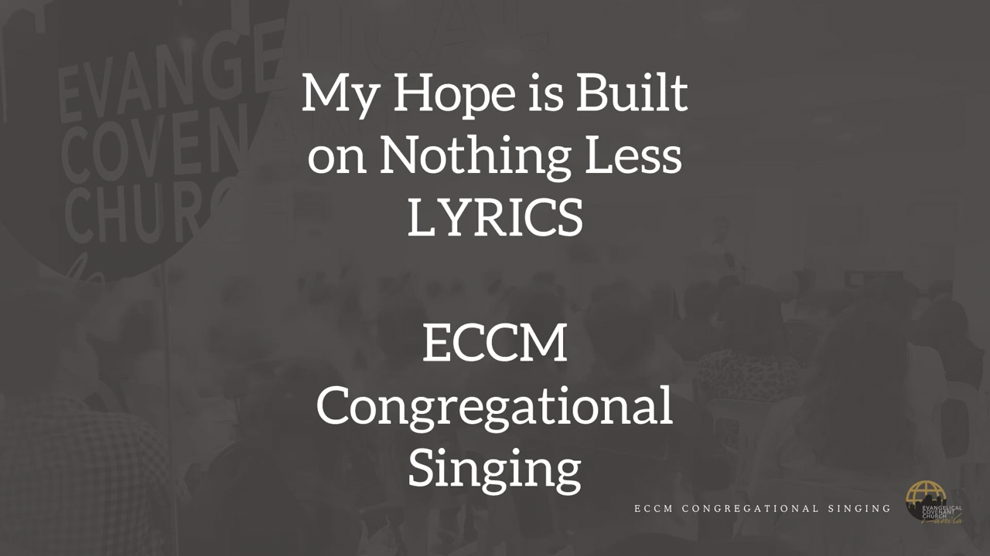

Slide 3


Slide 4
You Tube you tube url’s
My Hope Is Built
https://www.youtube.com/watch?v=VyXz8h5Qop8
You Are Holy
https://www.youtube.com/watch?v=dFeFrHvbSbk

Slide 5
” One generation shall praise thy works to another, And shall declare thy mighty acts”.
Psalm 145:4

