Slide 1

” One generation shall praise thy works to another, And shall declare thy mighty acts”.
Psalm 145:4

Slide 2

The Passion of The Christ
https://vimeo.com/110230931?fbclid=IwAR3IgU1kdWhQJtWySrsJ85i1qY0YOXbD4EfwH0fmQiPzvZS_DXnl1CU2Z6o

Slide 4
The Old Rugged Cross
https://www.youtube.com/watch?v=7ZM-BQ_KMy4

Slide 6
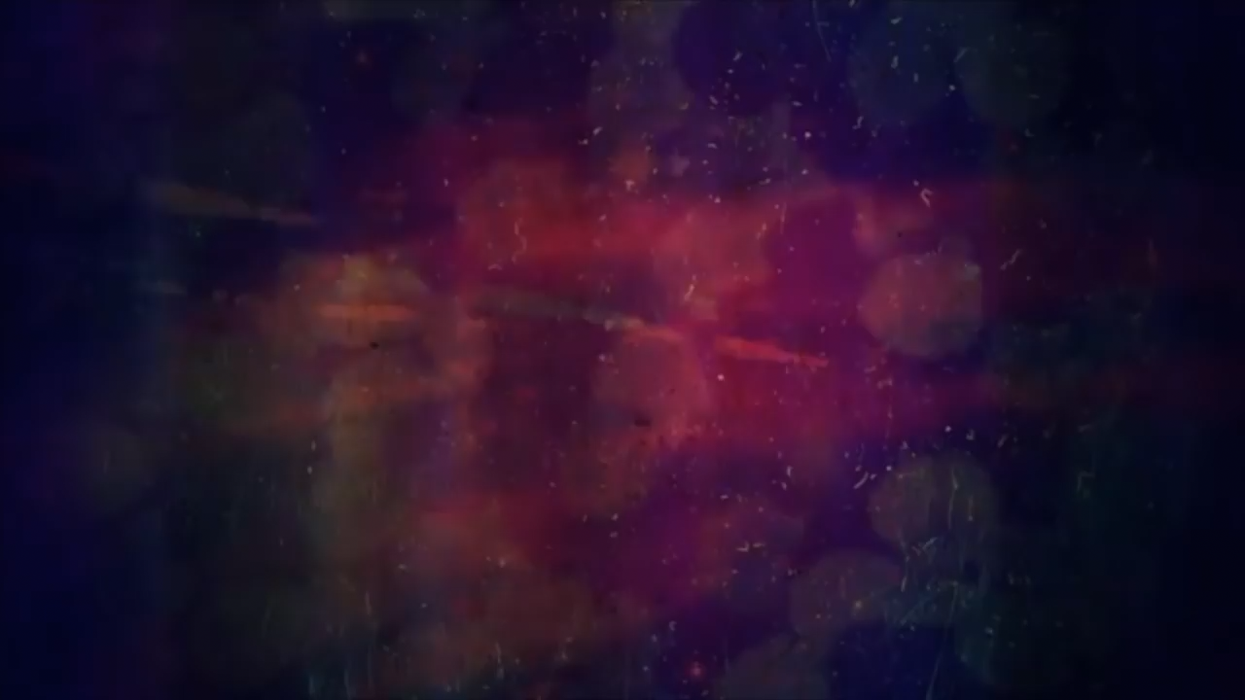
The Blood Will Never Lose It’s Power
https://www.youtube.com/watch?v=BD7ePQjXldI

Slide 8
” One generation shall praise thy works to another, And shall declare thy mighty acts”.
Psalm 145:4

