Slide 1

” One generation shall praise thy works to another, And shall declare thy mighty acts”.
Psalm 145:4

Slide 2
Standing On The Promises
Verse 1
Standing on the promises of
Christ my King
Through eternal ages
let His praises ring
https://www.youtube.com/watch?v=H_jmAHfv0CE

Slide 3
Standing On The Promises
Verse 1
Glory in the highest
I will shout and sing
Standing on the
Promises of God.

Slide 4
Standing On The Promises
chorus
Standing Standing
Standing on the promises of
God my Savior

Slide 5
Standing On The Promises
chorus
Standing Standing
I’m standing on the
Promises of God

Slide 6
Standing On The Promises
Verse 2
Standing on the promises
That cannot fail
When the howling storms
Of doubt and fear assail

Slide 7
Standing On The Promises
Verse 2
By the living Word of God
I shall prevail
Standing on the
Promises of God

Slide 8
Standing On The Promises
chorus
Standing Standing
Standing on the promises of
God my Savior

Slide 9
Standing On The Promises
chorus
Standing Standing
I’m standing on the
Promises of God

Slide 10
Standing On The Promises
Verse 3
Standing on the promises
I now can see
Perfect present cleansing
In the blood for me

Slide 11
Standing On The Promises
Verse 3
Standing in the liberty
Where Christ makes free
Standing on the
Promises of God

Slide 12
Standing On The Promises
chorus
Standing Standing
Standing on the promises of
God my Savior

Slide 13
Standing On The Promises
chorus
Standing Standing
I’m standing on the
Promises of God

Slide 14
Standing On The Promises
Verse 4
Standing on the promises
O Christ my Lord
Bound to Him eternally
By love’s strong chord

Slide 15
Standing On The Promises
Verse 4
Overcoming daily with
The Spirit’s sword
Standing on the
Promises of God

Slide 16
Standing On The Promises
chorus
Standing Standing
Standing on the promises of
God my Savior

Slide 17
Standing On The Promises
chorus
Standing Standing
I’m standing on the
Promises of God

Slide 18
Standing On The Promises
Verse 5
Standing on the promises
I shall not fall
List’ning every moment
To the Spirit’s call

Slide 19
Standing On The Promises
Verse 5
Resting in my Savior
As my All in all
Standing on the
Promises of God

Slide 20
Standing On The Promises
chorus
Standing Standing
Standing on the promises of
God my Savior

Slide 21
Standing On The Promises
chorus
Standing Standing
I’m standing on the
Promises of God

Slide 22
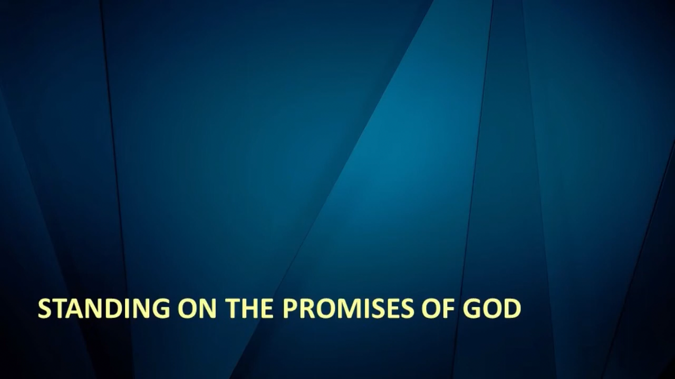

Slide 24
My Hope Is Built on Nothing Less
Verse 1
My hope is built on nothing less
Than Jesus' blood and righteousness
I dare not trust the sweetest frame
But wholly lean on Jesus' name

Slide 25
My Hope Is Built on Nothing Less
chorus
On Christ the solid rock I stand
All other ground is sinking sand
All other ground is sinking sand

Slide 26
My Hope Is Built on Nothing Less
Verse 2
When darkness veils his lovely face
I rest on His unchanging grace
In every high and stormy gale
My anchor holds within the veil

Slide 27
My Hope Is Built on Nothing Less
chorus
On Christ the solid rock I stand
All other ground is sinking sand
All other ground is sinking sand

Slide 28
My Hope Is Built on Nothing Less
Verse 3
His oath, his covenant, his blood
Supports me in the 'whelming flood
When all around my soul gives way
He then is all my hope and stay

Slide 29
My Hope Is Built on Nothing Less
chorus
On Christ the solid rock I stand
All other ground is sinking sand
All other ground is sinking sand
(repeat)

Slide 30
My Hope Is Built on Nothing Less
Verse 4
When He shall come
With trumpet sound
Oh may I then in Him be found
Dressed in his righteousness alone
Faultless to stand before the throne

Slide 31
My Hope Is Built on Nothing Less
chorus
On Christ the solid rock I stand
All other ground is sinking sand
All other ground is sinking sand
(repeat)

Slide 32
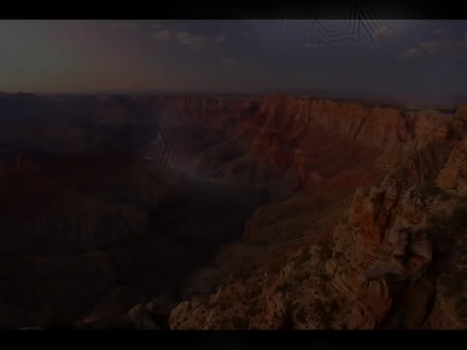

Slide 34
” One generation shall praise thy works to another, And shall declare thy mighty acts”.
Psalm 145:4

