Slide 1

” One generation shall praise thy works to another, And shall declare thy mighty acts”.
Psalm 145:4

Slide 2
10,000 Reasons (Bless the Lord)
Bless the Lord,
O my soul
O my soul
Worship His
Holy Name

Slide 3
10,000 Reasons (Bless the Lord)
Sing like never
Before
O my soul
I’ll worship Your
Holy Name

Slide 4
10,000 Reasons (Bless the Lord)
The sun comes up
it’s a new day
dawning
It’s time to sing
Your song again

Slide 5
10,000 Reasons (Bless the Lord)
Whatever
may pass
And whatever
lies before me

Slide 6
10,000 Reasons (Bless the Lord)
Let me be
singing
When the
evening comes

Slide 7
10,000 Reasons (Bless the Lord)
Bless the Lord,
O my soul
O my soul
Worship His
Holy Name

Slide 8
10,000 Reasons (Bless the Lord)
Sing like never
Before
O my soul
I’ll worship Your
Holy Name

Slide 9
10,000 Reasons (Bless the Lord)
You’re rich in love
And you’re slow to
anger
Your Name is great
And Your heart is
kind

Slide 10
10,000 Reasons (Bless the Lord)
For all Your
goodness
I will keep on singing
Ten thousand
reasons
For my heart to find

Slide 11
10,000 Reasons (Bless the Lord)
Bless the Lord,
O my soul
O my soul
Worship His
Holy Name

Slide 12
10,000 Reasons (Bless the Lord)
Sing like never
Before
O my soul
I’ll worship Your
Holy Name

Slide 13
10,000 Reasons (Bless the Lord)
And on that day
when my strength
is failing
The end draws near
And my time has
come

Slide 14
10,000 Reasons (Bless the Lord)
Still my soul
will sing
Your praise
unending

Slide 15
10,000 Reasons (Bless the Lord)
Ten thousand
Years
And then
forevermore

Slide 16
10,000 Reasons (Bless the Lord)
Bless the Lord,
O my soul
O my soul
Worship His
Holy Name

Slide 17
10,000 Reasons (Bless the Lord)
Sing like never
Before
O my soul
Worship Your
Holy Name

Slide 18
10,000 Reasons (Bless the Lord)
Bless the Lord,
O my soul
O my soul
Worship His
Holy Name

Slide 19
10,000 Reasons (Bless the Lord)
Sing like never
Before
O my soul
Worship Your
Holy Name

Slide 20
10,000 Reasons (Bless the Lord)
Yes, I will
worship
Your Holy
name

Slide 21
10,000 Reasons (Bless the Lord)
Lord, I’ll
worship
Your Holy
name

Slide 22
10,000 Reasons (Bless the Lord)
“Bless the Lord, O my soul, and all that is within me, bless His Holy name.” Psalm 103:1

Slide 23
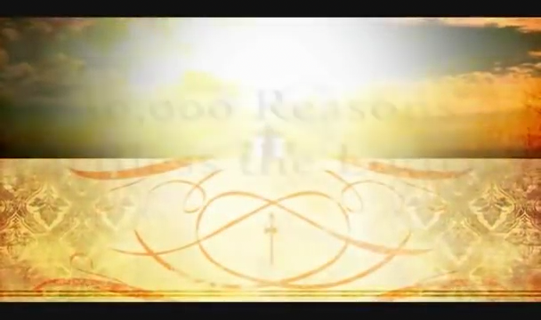

Slide 25
” One generation shall praise thy works to another, And shall declare thy mighty acts”.
Psalm 145:4

